Slide 1













Search . . .
EVENT HANDLING AND BASIC HOOKS
GROUP 2

Slide 2
TABLE OF CONTENTS
01
02
03
EVENT HANDLING
BASIC HOOKS
CODE EXPLANATION

Slide 3


01
EVENT HANDLING
Read More. . .

Slide 4



CODING
School
WHAT IS EVENT HANDLINGS ?
EVENT HANDLING IS ...
01
The process of responding to user actions (like clicks, key presses, or mouse movements) in a web application or software. In a user interface (UI), events are the interactions that happen in response to user actions.
02
WHEN AN EVENT OCCUR ...
The system needs to "handle" it, meaning it should perform some actions in response to that event

Slide 5

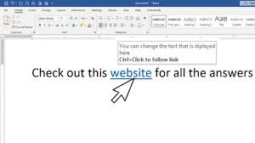

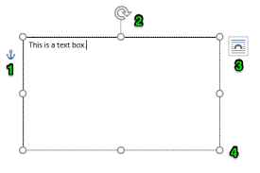

CODING
School
EXAMPLES
For example, a user clicking a button, hovering over a link, or typing in a text box are all events.

Slide 6
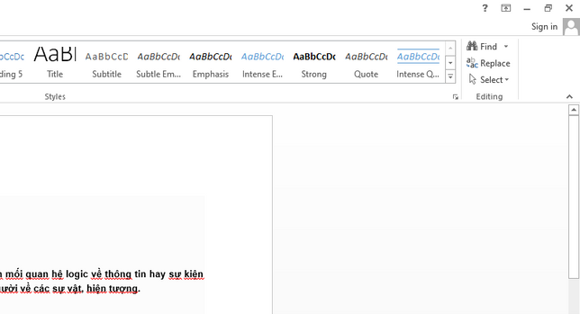

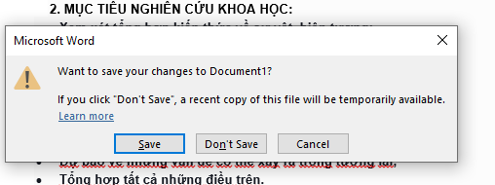

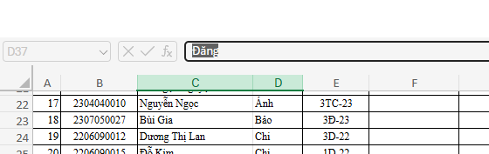

CODING
School
Search . . .
EXAMPLES
For example, when a button is clicked, you might want to display a message or change some data on the page.

Slide 7






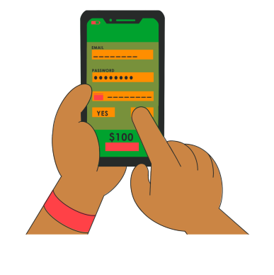

CODING
School
Search . . .
TYPES OF EVENTS
Mouse Events: click, dblclick, mouseover, mouseout, etc.
Touch Events (for mobile): touchstart, touchend, touchmove.
Keyboard Events: keydown, keyup, keypress.
Form Events: submit, change, focus, blur.
Custom Events: Events that you create and dispatch for custom interactions in your application.

Slide 8

CODING
School
Search . . .
SYNTHETIC EVENTS AND JSX EVENT HANDLERS
Read More. . .

Slide 9
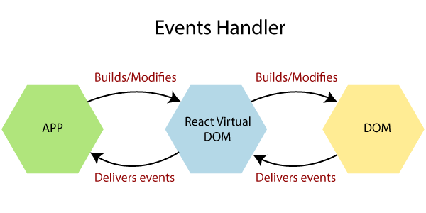
CODING
School
Search . . .
Synthetic Events and JSX Event Handlers are fundamental components of event handling in React. They help manage user interactions with the web page in a way that is efficient, cross-browser compatible, and easy to maintain.

Slide 10
CODING
School
Search . . .
WHAT ARE SYNTHETIC EVENTS?
They normalize browser-specific differences, ensuring events work consistently across browsers.
Synthetic Events are React's custom event objects that wrap around native DOM events.

Slide 11
CODING
School
Search . . .
WHY REACT USES SYNTHETIC EVENTS?
React uses Synthetic Events for several important reasons, all of which improve performance, cross-browser compatibility, and ease of use when handling events in React applications.

Slide 12
CODING
School
Search . . .
HOW SYNTHETIC EVENTS WORK?
Event Pooling:
- Event Pooling is an optimization technique used in React's Synthetic Event system to improve performance and reduce memory usage.
- React pools event objects to avoid creating new event instances each time an event occurs. Instead of allocating a new object for each event, React reuses the event object after the event handler finishes running.

Slide 13
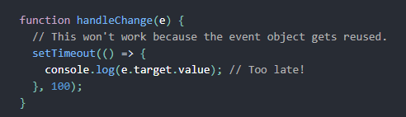
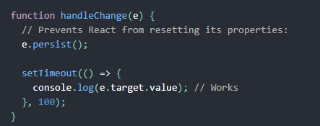
CODING
School
Search . . .
HOW SYNTHETIC EVENTS WORK?
Event Pooling: The Synthetic Event objects are pooled. This means that the SyntheticEvent object will be reused and all properties will be nullified after the event handler has been called. For example, this won’t work:
If you need to access event object’s properties after the event handler has run, you need to call e.persist():

Slide 14
CODING
School
Search . . .
HOW SYNTHETIC EVENTS WORK?
Event methods :
- An event method refers to functions on an event object that control or modify the event's behavior.
- In JavaScript (and React's Synthetic Events), these methods include stopping event propagation, preventing the default action, and accessing event properties like the target element.

Slide 15
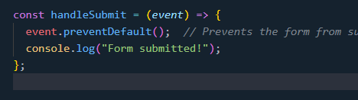
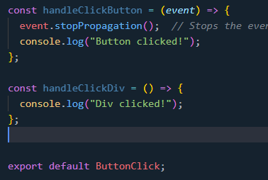
CODING
School
Search . . .
HOW SYNTHETIC EVENTS WORK?
Event methods :
- React’s Synthetic Event has methods like preventDefault() and stopPropagation(), just like native events.
event.preventDefault()
event.stopPropagation()
Purpose: Prevents the default behavior of the event.
Purpose: Stops the event from propagating (bubbling) up the DOM tree.

Slide 16
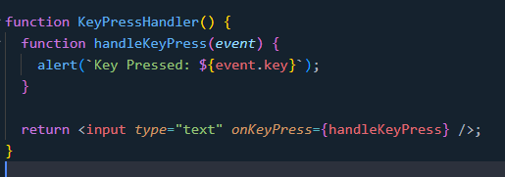
CODING
School
Search . . .
HANDLING DIFFERENT EVENT TYPES
Handling Keyboard Events

Slide 17
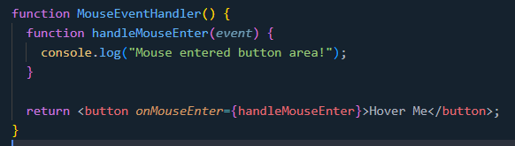
CODING
School
Search . . .
HANDLING DIFFERENT EVENT TYPES
Handling Mouse Events

Slide 18
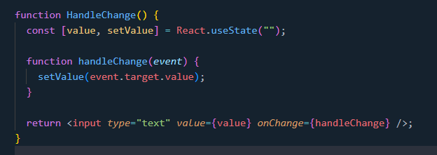
CODING
School
Search . . .
HANDLING DIFFERENT EVENT TYPES
Handling Form Events

Slide 19
CODING
School
Search . . .
WHY SYNTHETIC EVENTS ARE IMPORTANT?
Consistency: Different browsers handle events inconsistently, Synthetic Events standardize them for uniform behavior.
Performance: React reuses event objects, which reduces memory usage and improves performance, especially when many events are fired.
Simplicity: React handles a lot of the complexity for you by automatically binding events to the correct elements and managing the event listeners.

Slide 20
Search . . .
WHAT ARE JSX EVENT HANDLERS?
JSX event handlers in React are functions that handle user interactions (clicks, typing, etc.). Unlike HTML, React uses camelCase versions of event names (e.g., onClick, onChange, onSubmit) to specify how elements should respond to events. These handlers are attached to JSX elements to define the desired behavior.

Slide 21
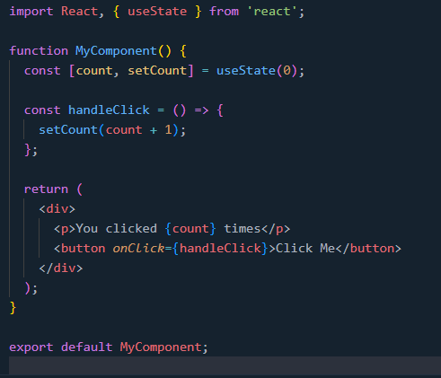
CODING
School
Search . . .
EXAMPLE
The onClick is a JSX event handler attached to the <button> element.
The handleClick function is triggered when the button is clicked, updating the count state.

Slide 22

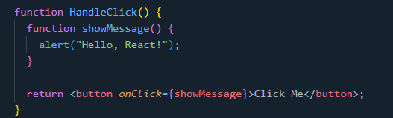
CODING
School
Search . . .
JSX EVENT HANDLER SYNTAX & RULES
JSX Event Handler Basics
In JSX, events are written in camelCase (e.g., onClick instead of onclick)
The event handler is passed as a function reference, not a string.
Example: Button Click Event

Slide 23

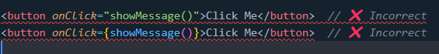
CODING
School
Search . . .
JSX EVENT HANDLER SYNTAX & RULES
Incorrect JSX Event Handling
In JSX, events are written in camelCase (e.g., onClick instead of onclick)
The event handler is passed as a function reference, not a string.
Example: Button Click Event

Slide 24

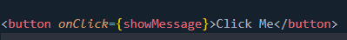
CODING
School
Search . . .
JSX EVENT HANDLER SYNTAX & RULES
Incorrect JSX Event Handling
Example: Button Click Event
Why incorrect?
The first example treats the function as a string (wrong in JSX).
The second example calls the function immediately instead of passing a reference.
Correct Approach:

Slide 25
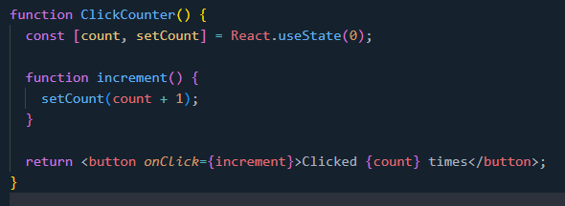
CODING
School
Search . . .
HANDLING EVENTS IN FUNCTIONAL & CLASS COMPONENTS
🔹 In Functional Components (Modern React)

Slide 26
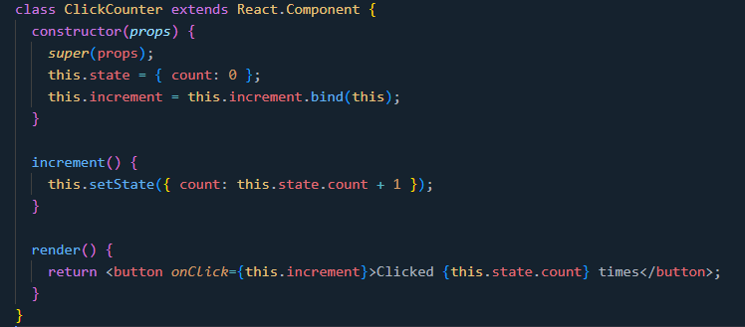
CODING
School
Search . . .
HANDLING EVENTS IN FUNCTIONAL & CLASS COMPONENTS
🔹 In Class Components (Older React)

Slide 27
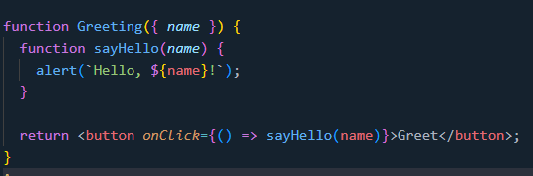
CODING
School
Search . . .
PASSING ARGUMENTS TO EVENT HANDLERS
Arguments can be passed using an inline arrow function or a function closure.
Avoid using .bind(this, args) inside render methods as it creates a new function on each render, affecting performance.
Example 1: Using Arrow Function

Slide 28
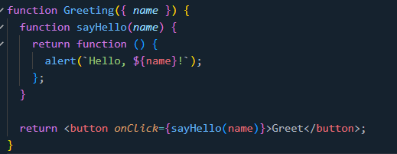
CODING
School
Search . . .
PASSING ARGUMENTS TO EVENT HANDLERS
Example 2: Using Function Closure

Slide 29
02
BASIC HOOKS
Read More. . .

Slide 30

WHAT IS REACT HOOKS?
Search . . .
Introduced in React 16.8.
Allows functional components to use state and other React features.
Removes the need for class components in state management.

Slide 31

WHAT WILL WE COVER?
Search . . .
Understanding:
useEffect - Managing Side Effects in React
useState - Managing Sate in functional Component
Basic usage and syntax.
Practical examples of it

Slide 32

Search . . .
2.1. useState - Managing Sate in functional Component
BASIC GUIDE & PRACTICAL EXAMPLES

Slide 33

What is useState?
Search . . .
useState is a built-in React Hook for managing state in functional components.
state: Current state value.
setState: Function to update the state.
initialValue: The initial state value.

Slide 34
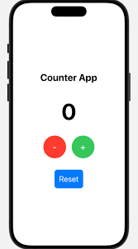
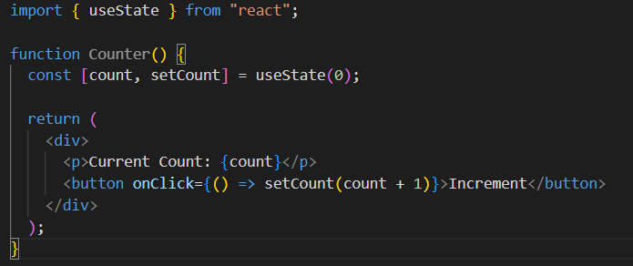
Example 1 - Counter App
Search . . .
Clicking the button updates the count state.
The component re-renders when the state changes.

Slide 35
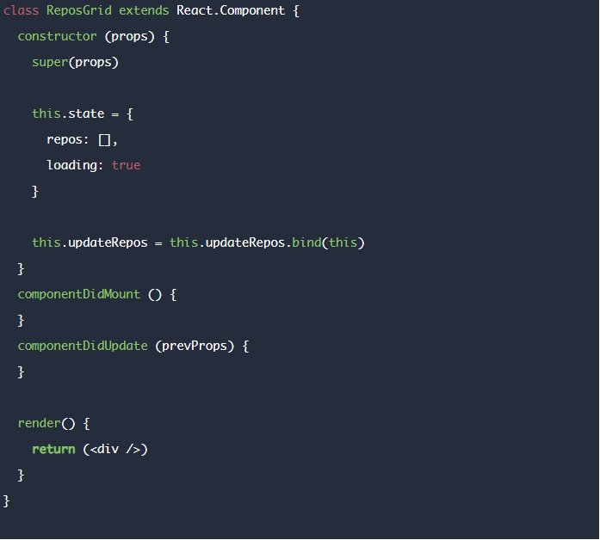
Why use useState?
Search . . .
Simpler and cleaner code compared to class components.
No need for this.state or this.setState.
Improves readability and maintainability of components.

Slide 36
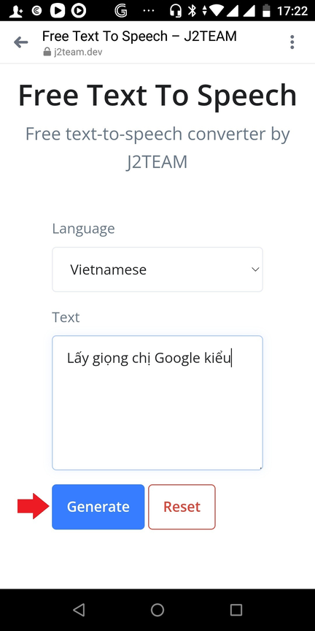
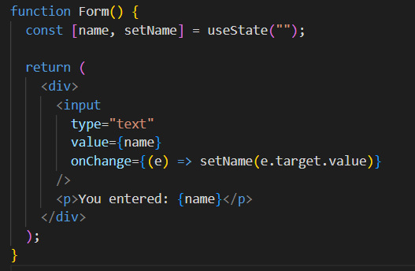
Example 2 - Form Input
Search . . .
Example: Managing input field values
Updates state dynamically as the user types.
Demonstrates controlled components in React.

Slide 37
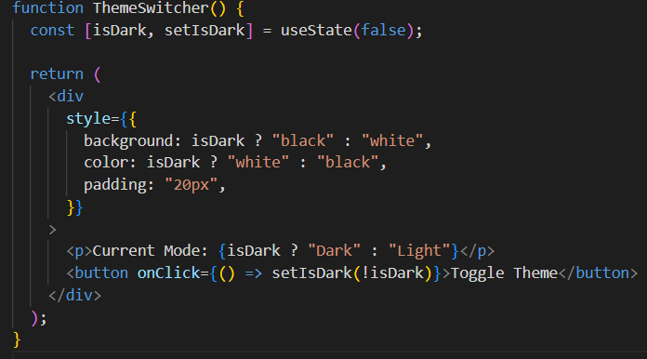
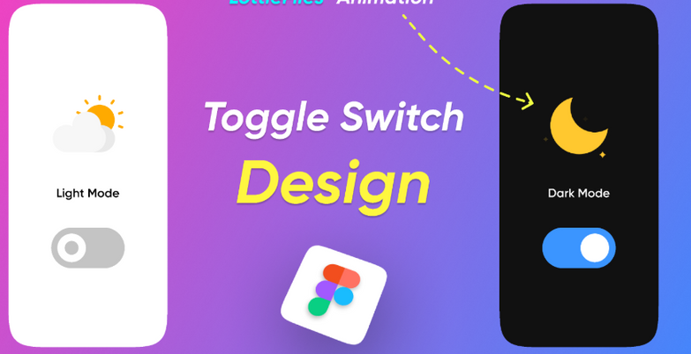
Search . . .
useState with Toggle (Theme Switcher)
Example: Switching between light and dark themes.
Demonstrates how state can be used to toggle UI elements.

Slide 38
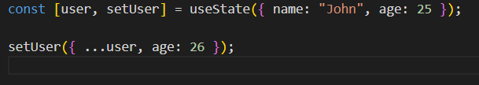
Updating State with Objects & ArraysState can hold objects and arrays
Search . . .
Avoid directly modifying state objects.
Always use the spread operator to maintain previous state values.

Slide 39

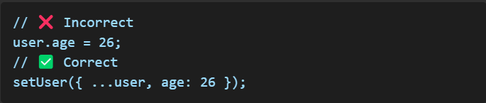
Best Practices & Common Mistakes
Search . . .
✅ Best Practices:
Use useState for local component state.
Keep state updates minimal and efficient.
Use functional updates if the new state depends on the previous state:
❌ Common Mistakes:
Modifying state directly:
Forgetting to initialize state properly.

Slide 40
Search . . .
Conclusion
useState enables state management in functional components.
Helps maintain interactive UI elements.
Simpler and more readable than class-based state.
Use best practices to avoid common pitfalls.

Slide 41
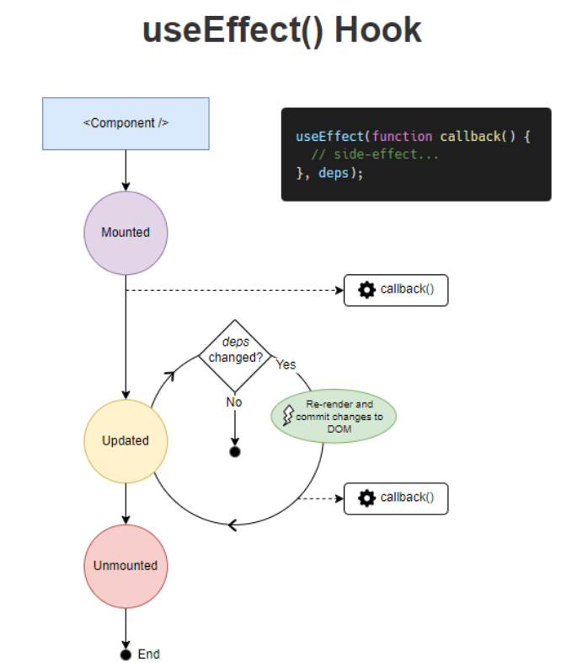
Search . . .
2.2. useEffect - Managing Side Effects in React
BASIC GUIDE & PRACTICAL EXAMPLES

Slide 42
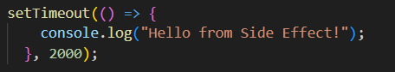
CODING
School
Search . . .
WHAT ARE SIDE EFFECTS?
Side effects are actions that occur outside the main render flow of a React component.
🟢Common examples:
Fetching API data.
Updating the webpage title or modifying the DOM.
Listening to browsfer events (resize, scroll).
Setting timers like setTimeout, setInterval.
🟠 Issue: If not handled properly, side effects can cause memory leaks and performance issues.

Slide 43
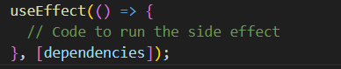
CODING
School
Search . . .
WHAT IS USEEFFECT?
🟢useEffect is a React Hook for managing side effects in function components.
🟢 It replaces lifecycle methods in class components:
componentDidMount
componentDidUpdate
componentWillUnmount
🟢 Executes after every render or when dependencies change.
📌 Note: dependencies control when the effect runs.

Slide 44
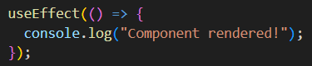
CODING
School
Search . . .
USEEFFECT WITHOUT DEPENDENCIES
🟢If there are no dependencies ([ ]), useEffect runs after every render.
🟢This can cause performance issues if not controlled properly.
📌 Example: Logs a message every time the component renders.
📌 Note: This effect runs continuously, potentially leading to logic errors.

Slide 45
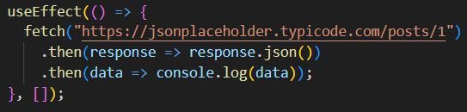
CODING
School
Search . . .
USEEFFECT WITH AN EMPTY DEPENDENCY ARRAY ([])
🟢When useEffect has an empty dependency array ([ ]), it runs only once after the initial render.
🟢Equivalent to componentDidMount in class components.
📌 Example: Fetch API only once when the component mounts.
📌 Note: This is optimal for API calls on component mount.

Slide 46
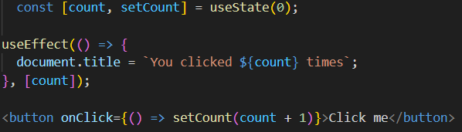
CODING
School
Search . . .
USEEFFECT WITH SPECIFIC DEPENDENCIES
🟢When using dependencies, useEffect runs only when specified values change.
🟢Equivalent to componentDidUpdate.
📌 Example: Update the webpage title when count changes.
📌Note: If the dependency changes frequently, the effect will run multiple times.

Slide 47
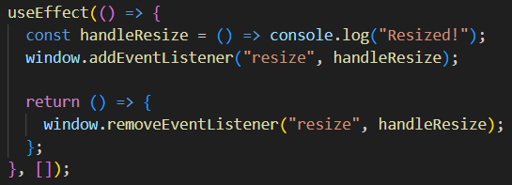
CODING
School
Search . . .
CLEANUP IN USEEFFECT
📌 Example: Listen to resize events and clean up when the component unmounts.
Some side effects need cleanup to avoid memory leaks.
useEffect can return a cleanup function, which runs before the component unmounts or before the effect re-runs.
📌 Note: Without cleanup, event listeners will persist, causing memory leaks.

Slide 48
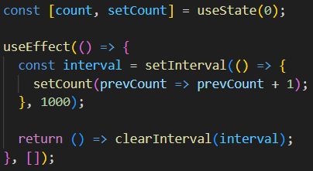
CODING
School
Search . . .
USEEFFECT WITH TIMERS (SETINTERVAL, SETTIMEOUT)
🟢When using setInterval or setTimeout, cleanup is needed to avoid issues.
📌 Example: Automatically increment a counter every second.
📌Note: Without cleanup, the timer continues running, even after unmounting.

Slide 49



CODING
School
Search . . .
SUMMARY
📌 Key Takeaways:
useEffect manages side effects in function components.
Without dependencies, useEffect runs after every render.
With an empty dependency array ([]), useEffect runs only once when the component mounts.
With specific dependencies, useEffect runs when those values change.
Always use cleanup functions when needed to prevent memory leaks.
HARDWARE
Presentations are tools that can be used as lectures, speeches.

Slide 50
03
CODE EXPLANATION
Read More. . .

Slide 51

Search . . .
THANK YOU

